Slide 1
Week Three

Slide 2
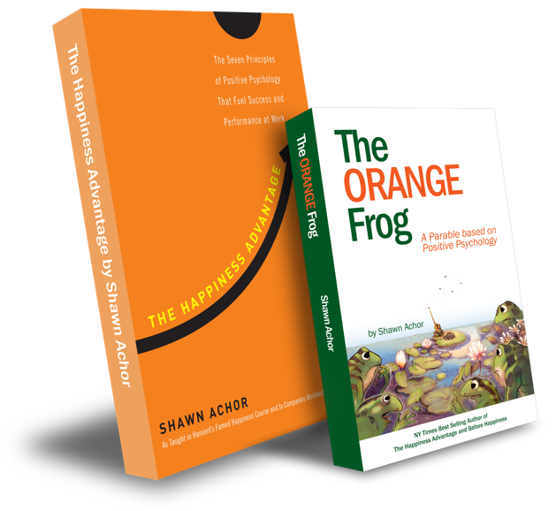
The Orange Frog
Gratitudes
Week 3
Creating Space
By Shawn Achor

Slide 3
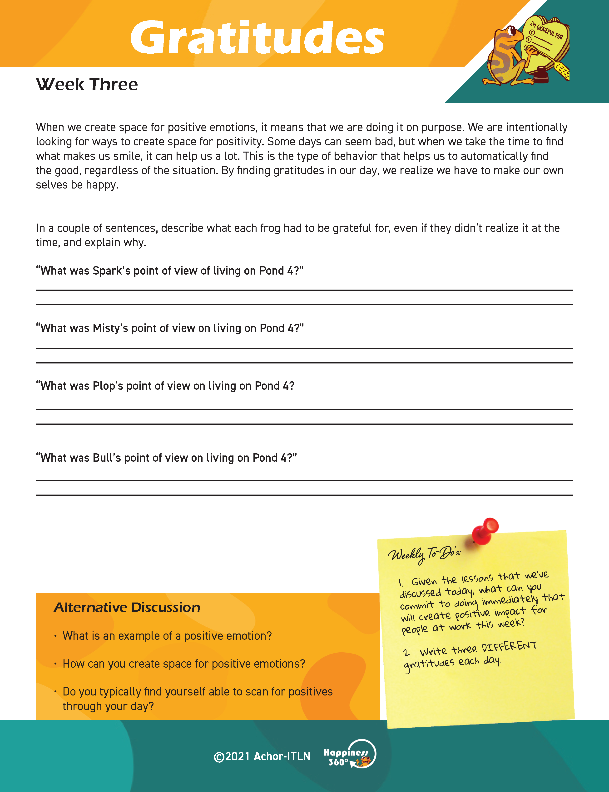
Each week, you’ll find a Worksheet in the resources section of the website and your Gratitude Journal.
Please, have those available.
\

Slide 4
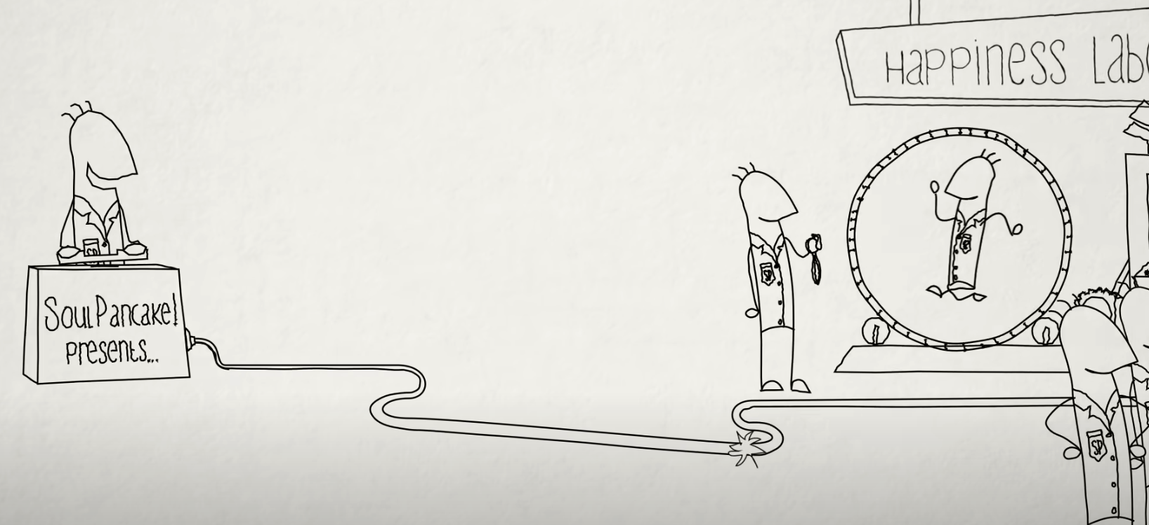
Did you get a chance to watch the Soul Pancake video on the science of happiness and upping your gratitude game? (Anyone get emotional?)
Prework
Expectations
Notes:
(Send this link out in advance.) Watch this video from Soul Pancake: https://youtu.be/oHv6vTKD6lg

Slide 5
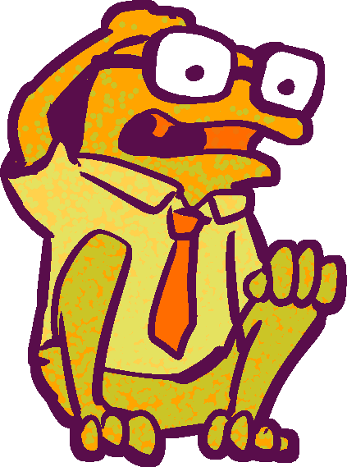
Gratitudes
Learning Objective: (“Each participant…”)
Can create space for positive emotions
Will discuss the importance of making the decision to scan my day for positives
Notes:
Standard:
Essential Concept and/or Skill: Communicate and work productively with others emphasizing collaboration and cultural awareness to produce quality work.
Interact positively as a team member.
Cooperate with others in a group setting.
Generate ideas with group members.
Are active listeners.
Read and understand information in a variety of forms.
Express ideas.
Skill:
Active listening, express ideas

Slide 6
Essential Concept
Demonstrate leadership, integrity, ethical behavior, and social responsibility in all environments.

Slide 7
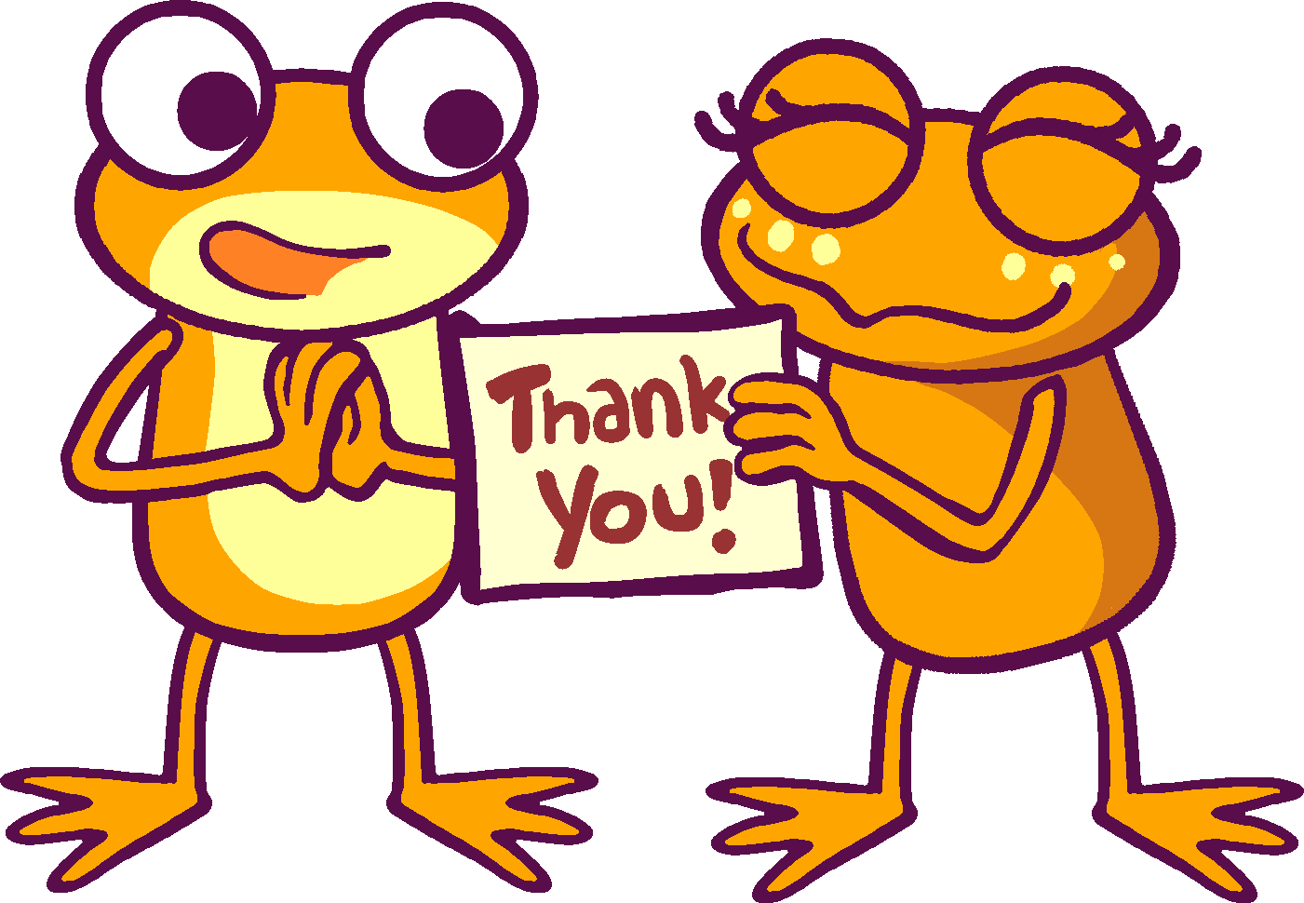
Skills
Self-management
Self-awareness
Communicate clearly
Collaborate on structured tasks
Show sensitivity to others’ views and ideas
Understand how to create consensus
Use active listening and speaking skills
Positively support the work of others

Slide 8
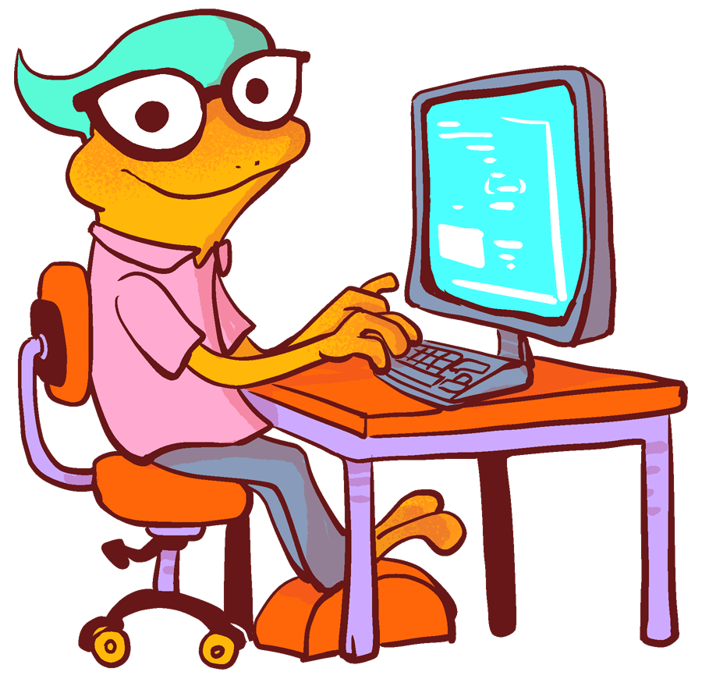
How often do you find yourself in a situation where there is an opportunity to create positive emotions for yourself and or others?

Slide 9
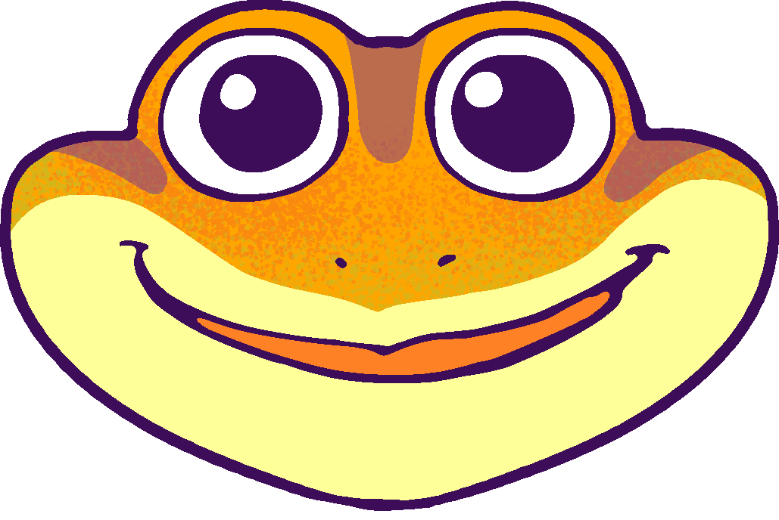
Thoughts on Creating Space
When we create space for positive emotions, it means that we are doing it on purpose.
We are intentionally looking for ways to create space for positivity.
Some days can seem bad, but when we take the time to find what makes us smile, it can help us a lot.
This is the type of behavior that helps us to automatically find the good, regardless of the situation.
By finding gratitudes in our day, we realize we have to make ourselves be happy.
Notes:
When we create space for positive emotions, it means that we are doing it on purpose. We are intentionally looking for ways to create space for positivity. Some days can seem bad, but when we take the time to find what makes us smile, it can help us a lot. This is the type of behavior that helps us to automatically find the good, regardless of the situation. By finding what we’re grateful for in our day, we realize that happiness is a choice and starts with us!

Slide 10
Connecting this Lesson to Our Work
Are there places in our busy days at work where we can insert a gratitude practice, making space for the positives?
How could your example of a gratitude practice at work impact others and the organization as a whole?

Slide 11
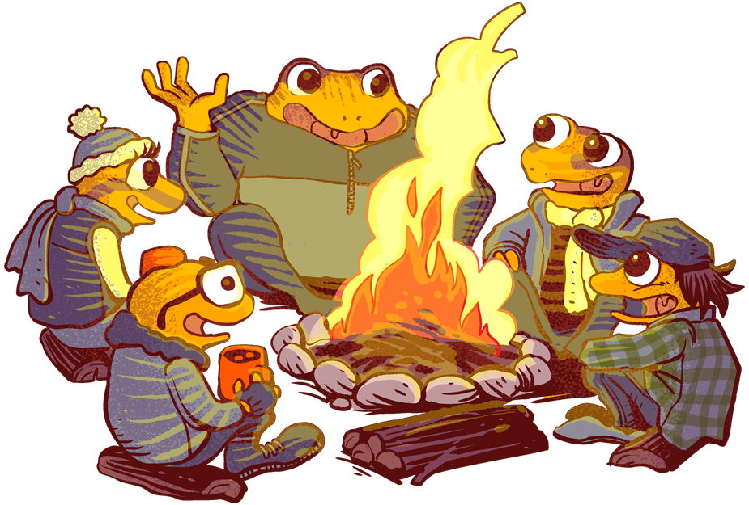
Action
During our time today, we are going to take a look at the gratitudes that the frogs of Pond 4 had.
Each frog had their own points of view on life around the pond.
In a couple of sentences, describe what each frog had to be grateful for, even if they didn’t realize it at the time, and explain why.
Notes:
During our time today, we are going to take a look at the gratitudes that the frogs of Pond 4 had. Each frog had their own points of view on life around the pond. In a couple of sentences, describe what each of the principal frogs (Misty, Plop, Bull, and Spark) had to be grateful for, even if they didn’t realize it at the time, and explain why.

Slide 12
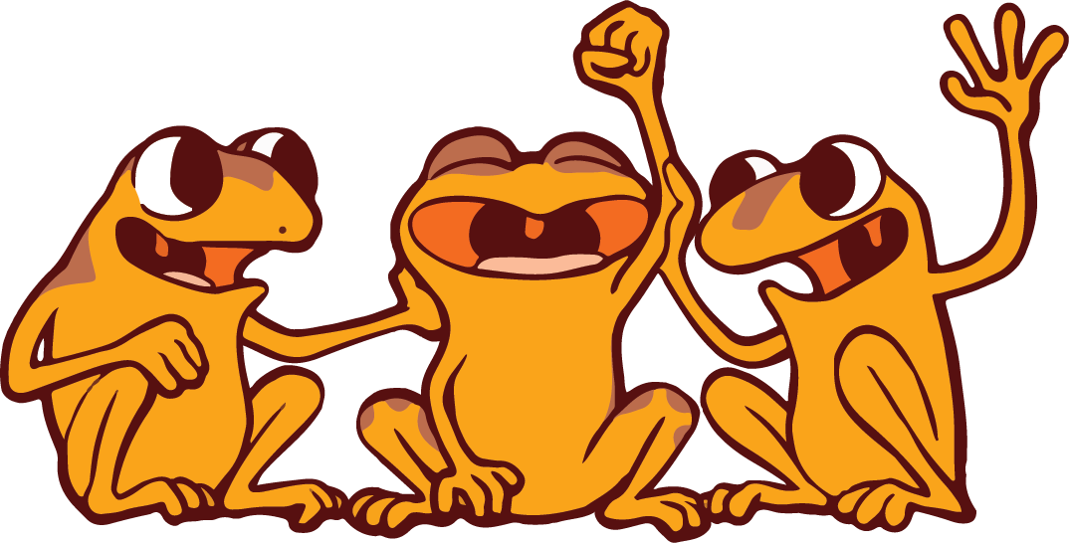
BONUS QUESTIONS
What is an example of a positive emotion?
How can you create space for positive emotions?
Do you typically find yourself able to scan for positives throughout your day?

Slide 13
Weekly To-Dos
Continue with your 21-day Gratitude challenge.
Make sure to use the Gratitude Journal to track your progress.

